Slide 1

Capturing Spatial Dependencies with Deep Neural Networks I
Yao-Yi Chiang
Computer Science and Engineering
University of Minnesota
yaoyi@umn.edu
CC-BY
Attribution

Slide 2

What have we covered so far?
Clustering
Dimension Reduction
Random Forest
Classification
Regression
https://vas3k.com/blog/machine_learning/
Notes:
https://vas3k.com/blog/machine_learning/

Slide 3
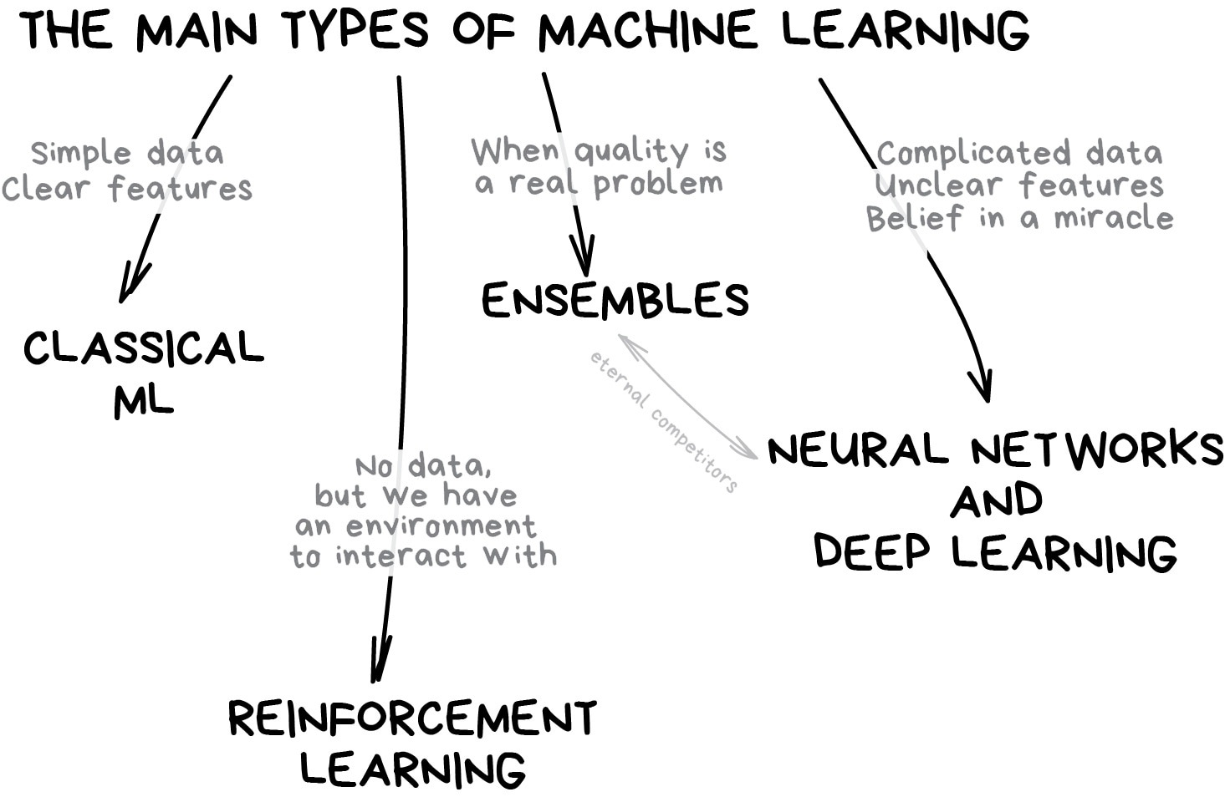
What have we covered so far?
Classical ML
Ensembles
https://vas3k.com/blog/machine_learning/

Slide 4
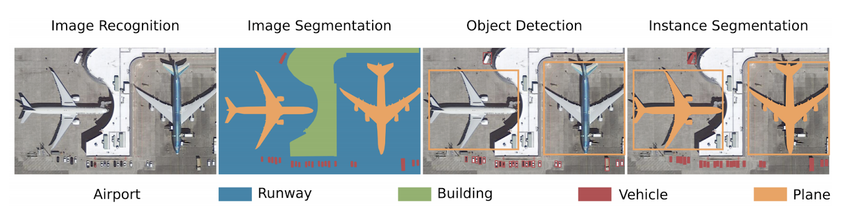
Overhead Imagery Understanding Tasks
Thorsten Hoeser and Claudia Kuenzer. 2020. Object detection and image segmentation with deep learning on earth observation data: A review-part i: Evolution and recent trends. Remote Sensing. Retrieved from https://www.mdpi.com/723500

Slide 5
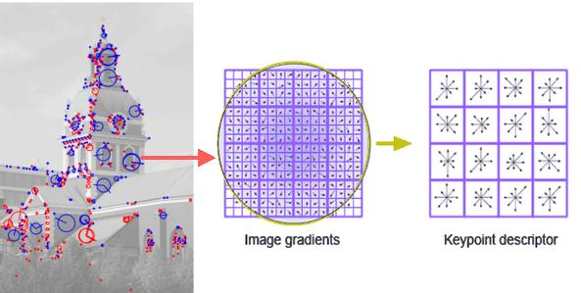
Object Detection & Recognition in 1999
SIFT (Scale Invariant Feature Transform)
SIFT is one of most popular image feature extraction and description algorithms
SIFT extracts feature points and describe them with a scale, illumination, and rotational invariant descriptor
https://www.codeproject.com/Articles/619039/Bag-of-Features-Descriptor-on-SIFT-Features-with-O

Slide 6
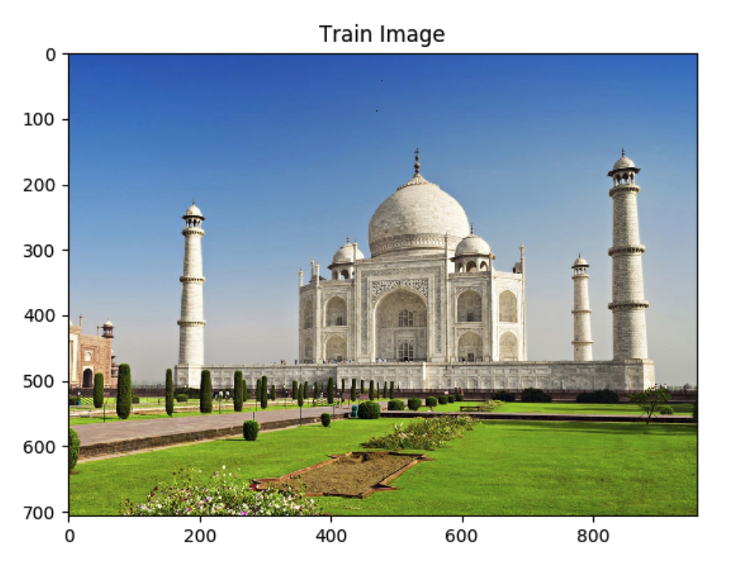
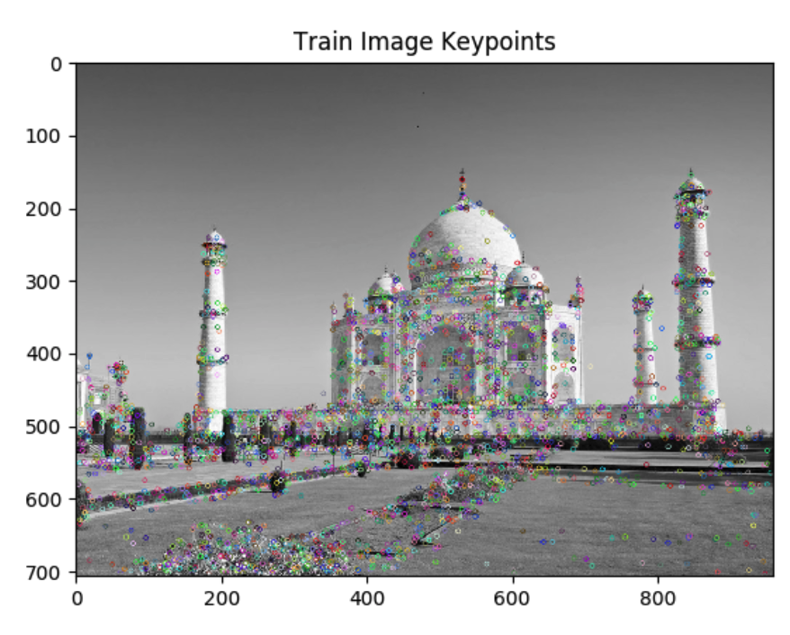
Object Detection & Recognition in 1999
SIFT (Scale Invariant Feature Transform)
https://iq.opengenus.org/scale-invariant-feature-transform/

Slide 7
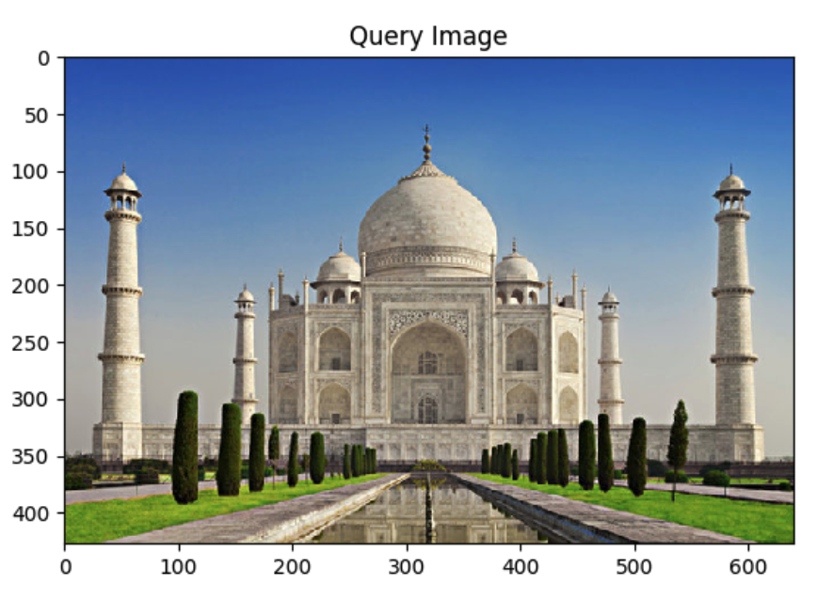
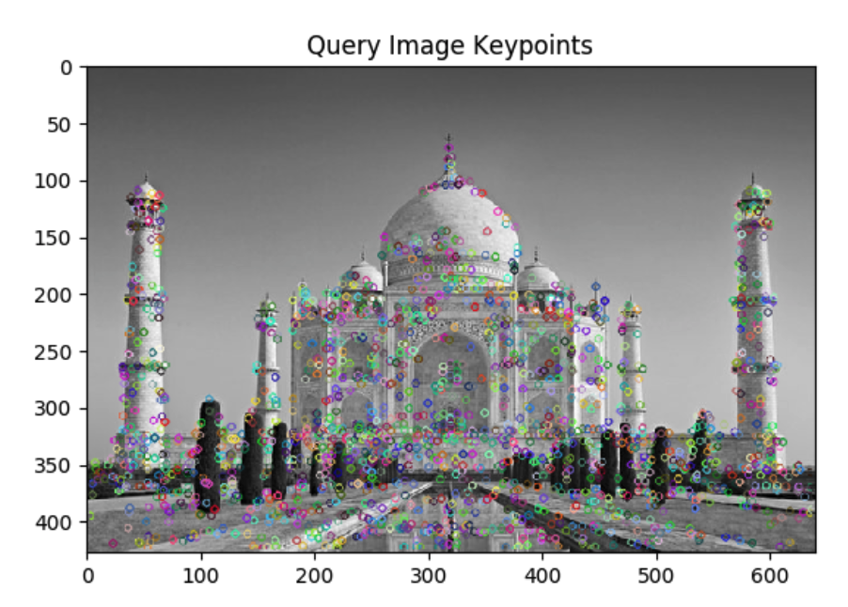
Object Detection & Recognition in 1999
SIFT (Scale Invariant Feature Transform)
https://iq.opengenus.org/scale-invariant-feature-transform/

Slide 8
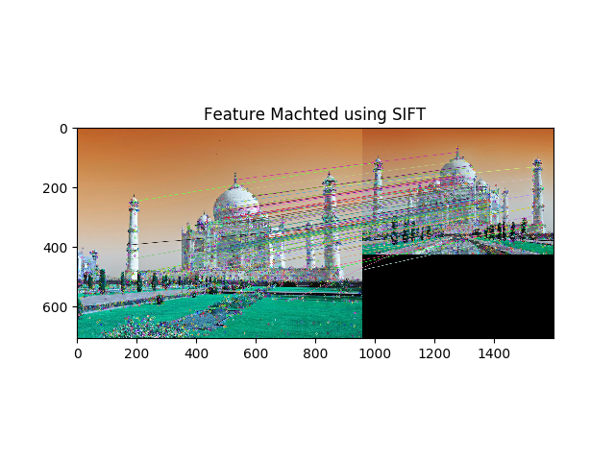
Object Detection & Recognition in 1999
SIFT (Scale Invariant Feature Transform)
https://iq.opengenus.org/scale-invariant-feature-transform/

Slide 9
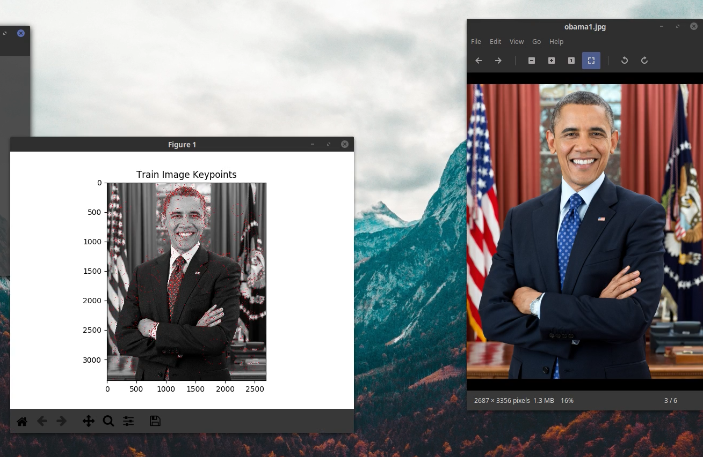
Object Detection & Recognition in 1999
SIFT (Scale Invariant Feature Transform)
https://iq.opengenus.org/scale-invariant-feature-transform/

Slide 10

Object Detection & Recognition in 1999
SIFT (Scale Invariant Feature Transform)
https://iq.opengenus.org/scale-invariant-feature-transform/

Slide 11
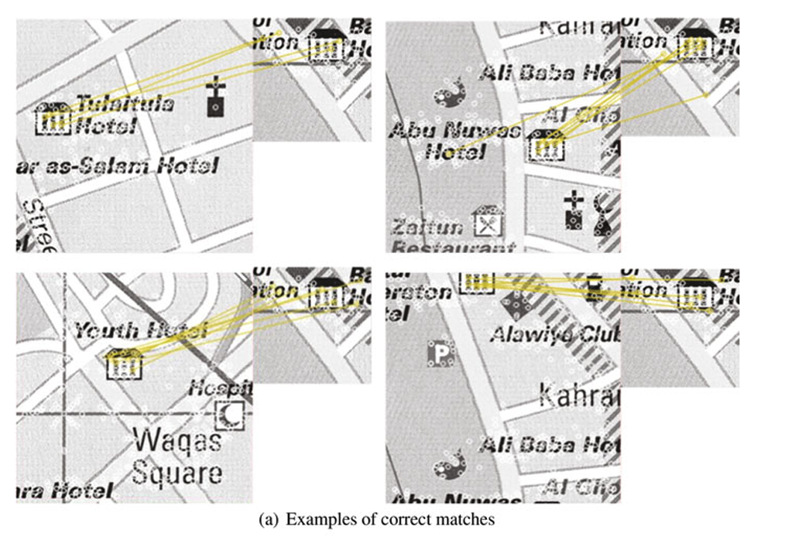
Map Processing
The small image on the right: hotel sample
The small white circles on the maps: SURF descriptors
The yellow lines connect matches between the SURF descriptors of the map area and the sample.
Using Historical Maps in Scientific Studies: Applications, Challenges, and Best Practices. Chiang, Y.; Duan, W.; Leyk, S.; Uhl, J. H; and Knoblock, C. A of SpringerBriefs in GeographySpringer International Publishing, 2020.

Slide 12
Handcrafted Image Features
Pros
Simple, easy to implement
Do not require significant computational power
Somehow explainable results
Cons
Not very robust (e.g., objects need to be very similar for a match)
Limited computer vision applications

Slide 13
What have we covered so far?
Classical ML
Ensembles
https://vas3k.com/blog/machine_learning/

Slide 14
Neural Networks and Deep Learning
A short introduction

Slide 15
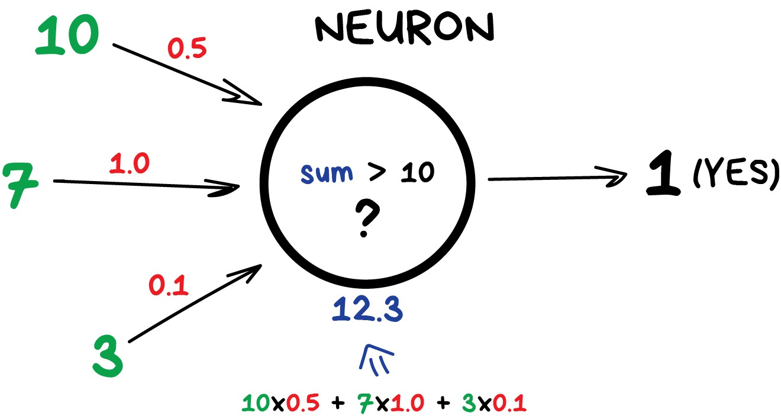
Deep Neural Networks
Neural networks with lots of “neurons” and layers

Slide 16
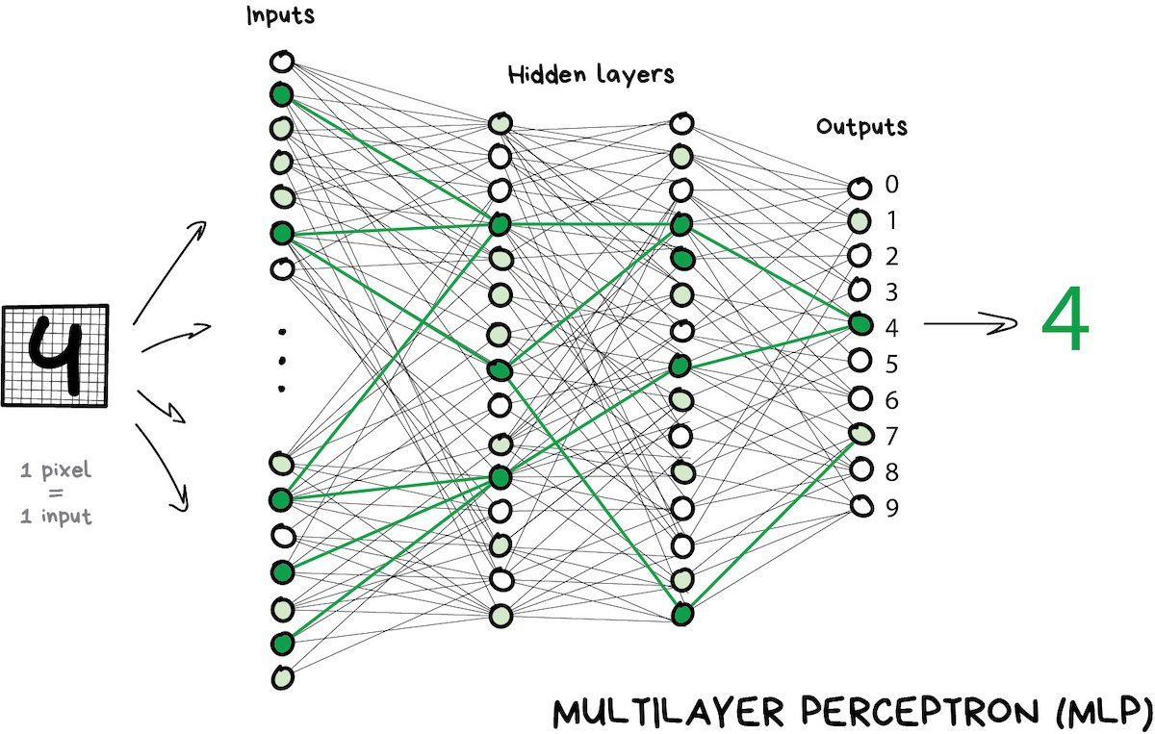
Deep Neural Networks
Neural networks with lots of “neurons” and layers
Flexible network modules
Can capture non-linear relationships in data
https://vas3k.com/blog/machine_learning/

Slide 17
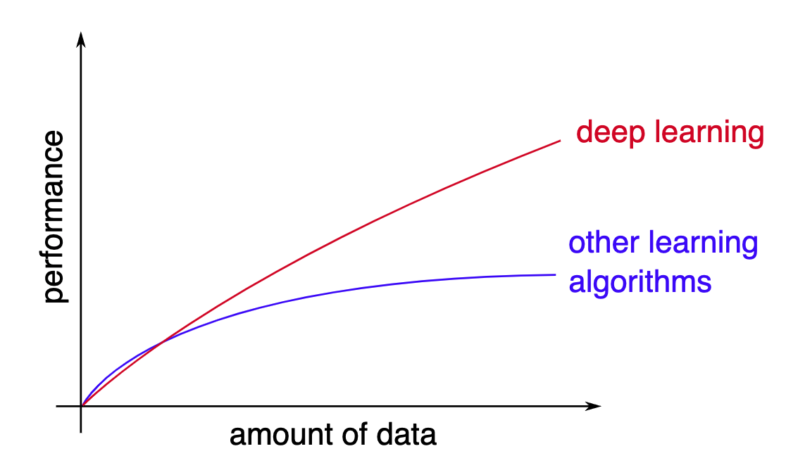
Deep Neural Networks
Neural networks with lots of “neurons” and layers
Flexible network modules
Can capture non-linear relationships in data
Can take advantage of large amounts of training data

Slide 18

Open Source Tools and Models

Slide 19
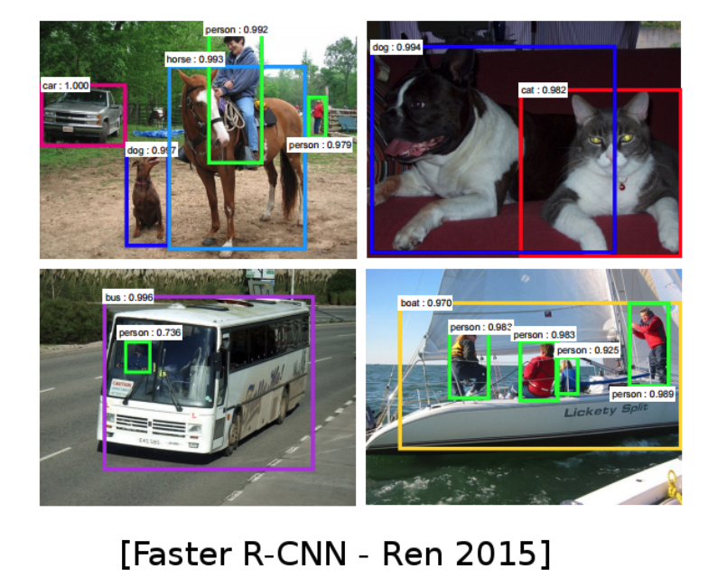
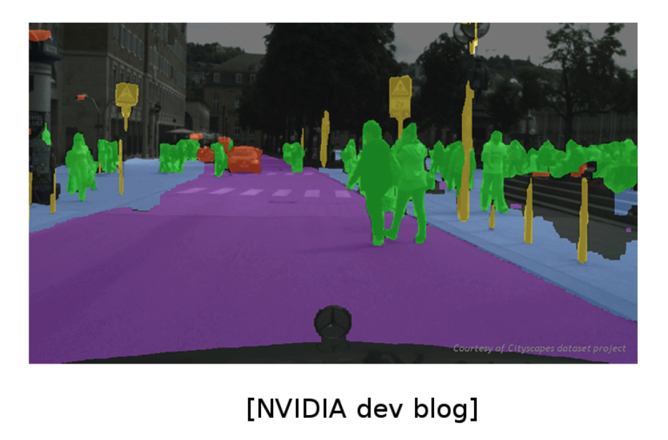
DL for Computer Vision

Slide 20
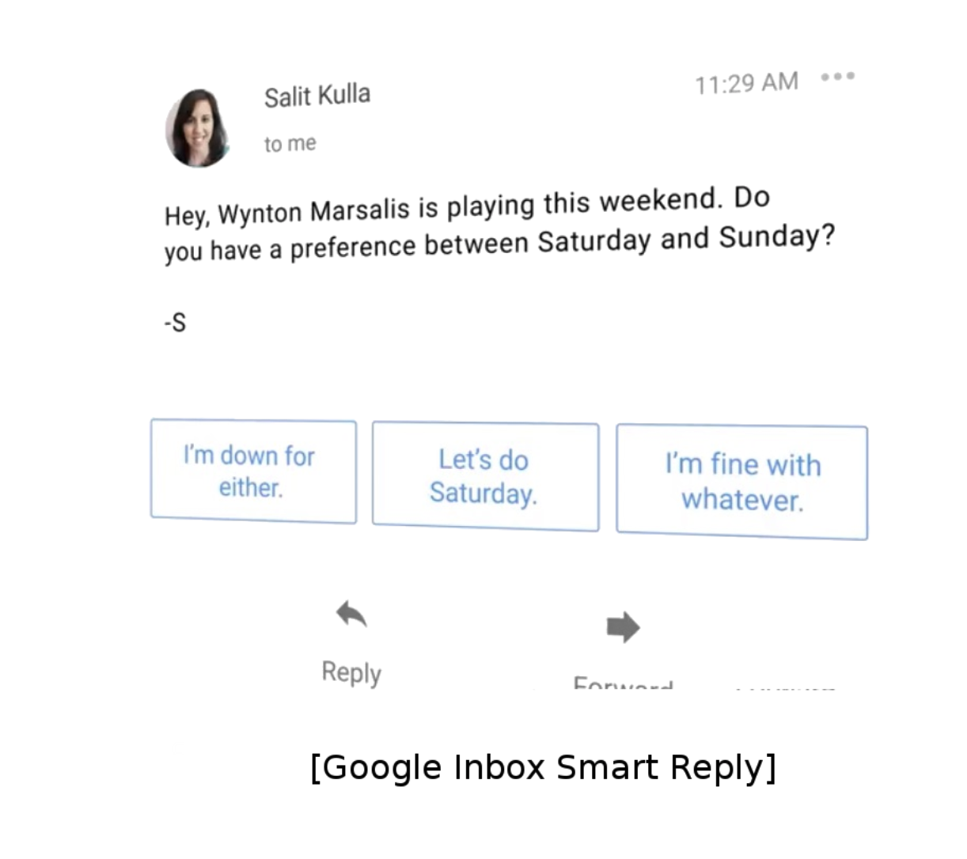
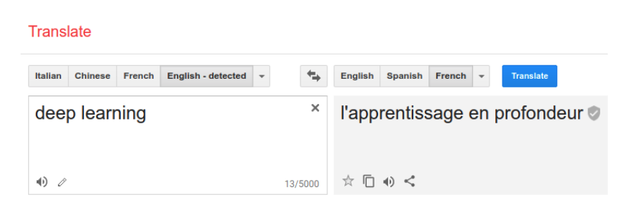
DL for Natural Language Processing

Slide 21
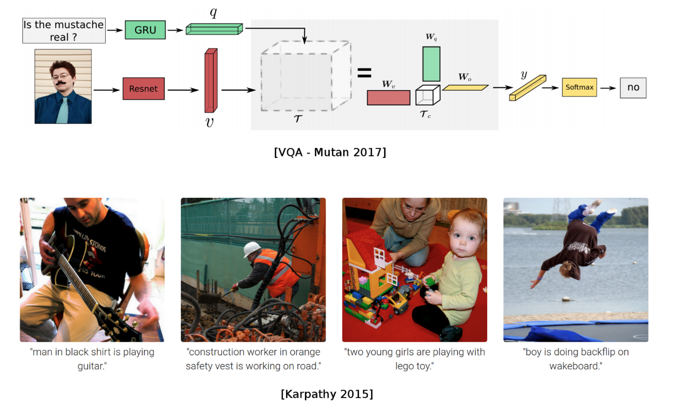
DL for CV + NLP

Slide 22
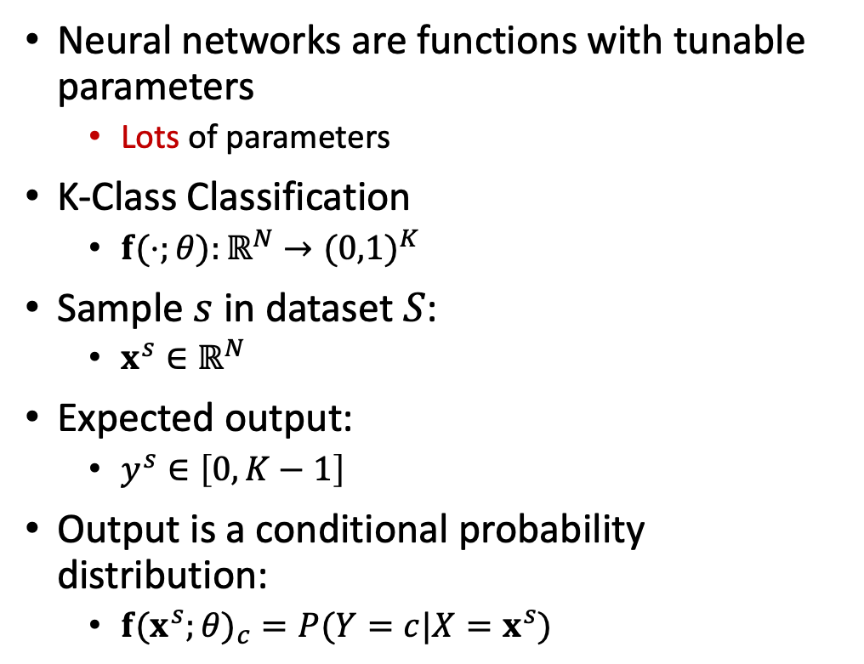
Neural Networks for Classification
Neural networks are functions with tunable parameters
Lots of parameters
K-Class Classification
$f(⋅;θ):ℝ^{N}→(0,1)^{K}$
Sample $s$ in dataset $S$:
$x^{s}∈ℝ^{N}$
Expected output:
$y^{s}∈\left[0,K−1\right]$
Output is a conditional probability distribution:
$f(x^{s};θ)_{c}=P(Y=c|X=x^{s})$

Slide 23
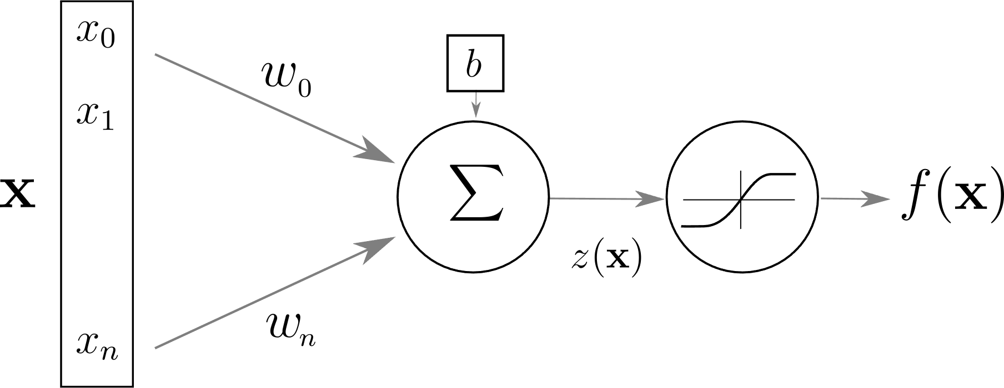
Artificial Neuron

Slide 24
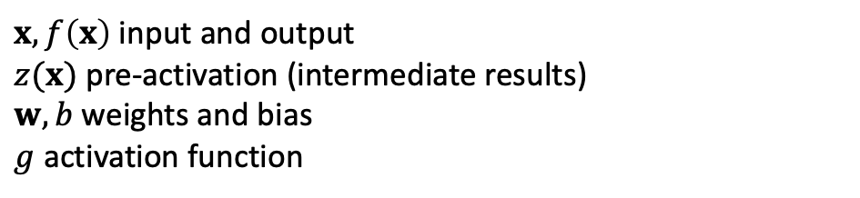
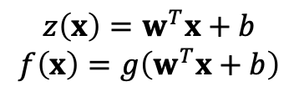
Artificial Neuron
$$z\left(x\right)=w^{T}x+b$$
$$f\left(x\right)=g\left(w^{T}x+b\right)$$
e.g., [0.01,0.03,0.04]^{T}x[1,2,3]+9
$x,f\left(x\right)$ input and output
$z(x)$ pre-activation (intermediate results)
$w,b$ weights and bias
$g$ activation function

Slide 25
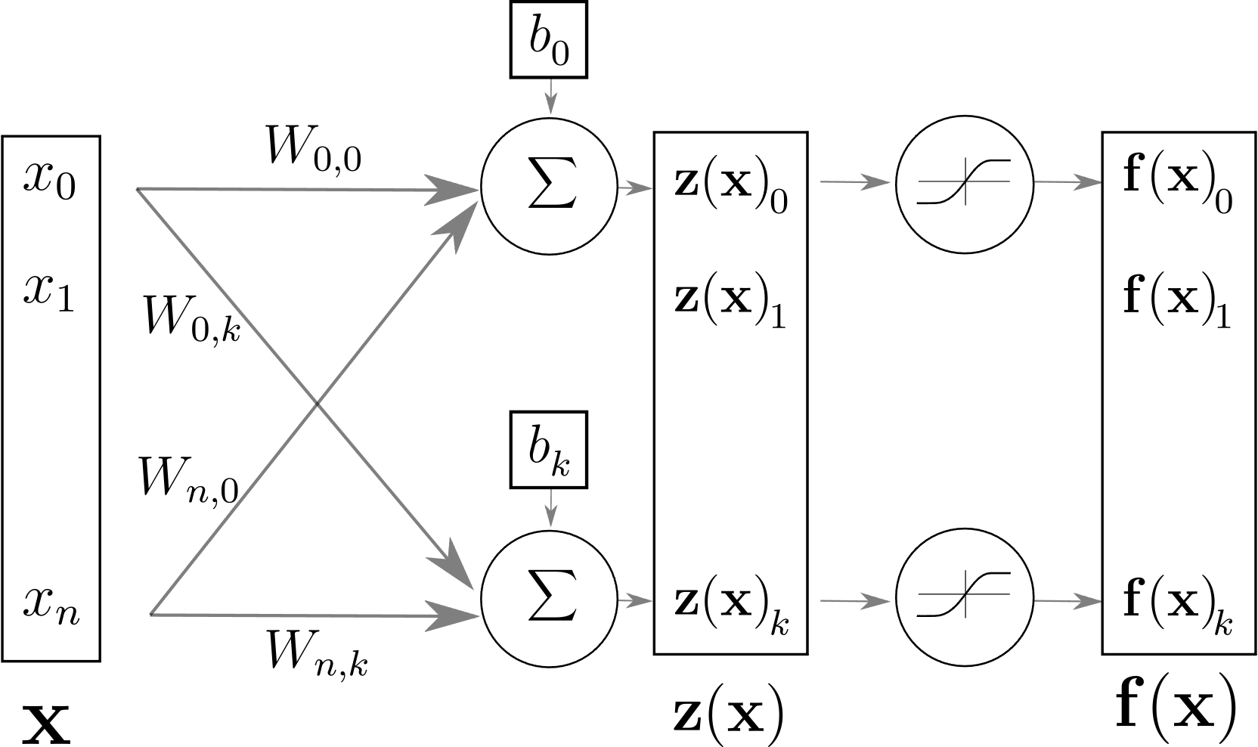
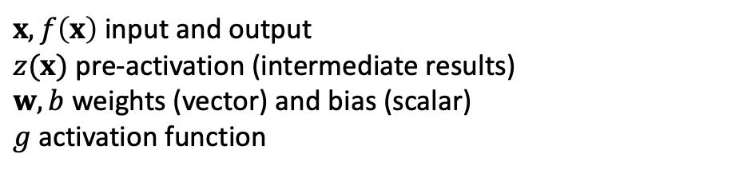
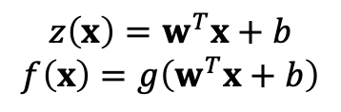
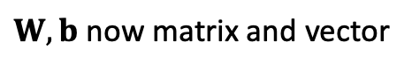

Layer of Neurons
$$z\left(x\right)=w^{T}x+b$$
$$f\left(x\right)=g\left(w^{T}x+b\right)$$
$x,f\left(x\right)$ input and output
$z(x)$ pre-activation (intermediate results)
$w,b$ weights (vector) and bias (scalar)
$g$ activation function
$$f\left(x\right)=g\left(z(x)\right)=g\left(Wx+b\right)$$
$W,b$ now matrix and vector

Slide 26
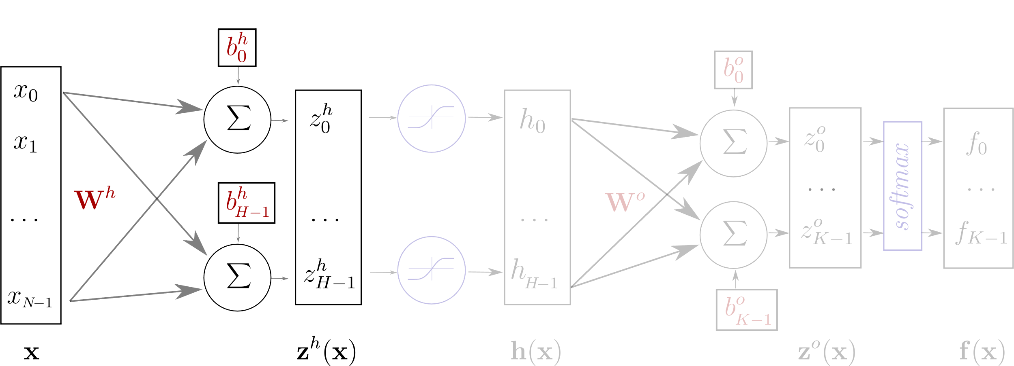
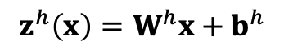
One Hidden Layer Network
$$z^{h}\left(x\right)=W^{h}x+b^{h}$$

Slide 27
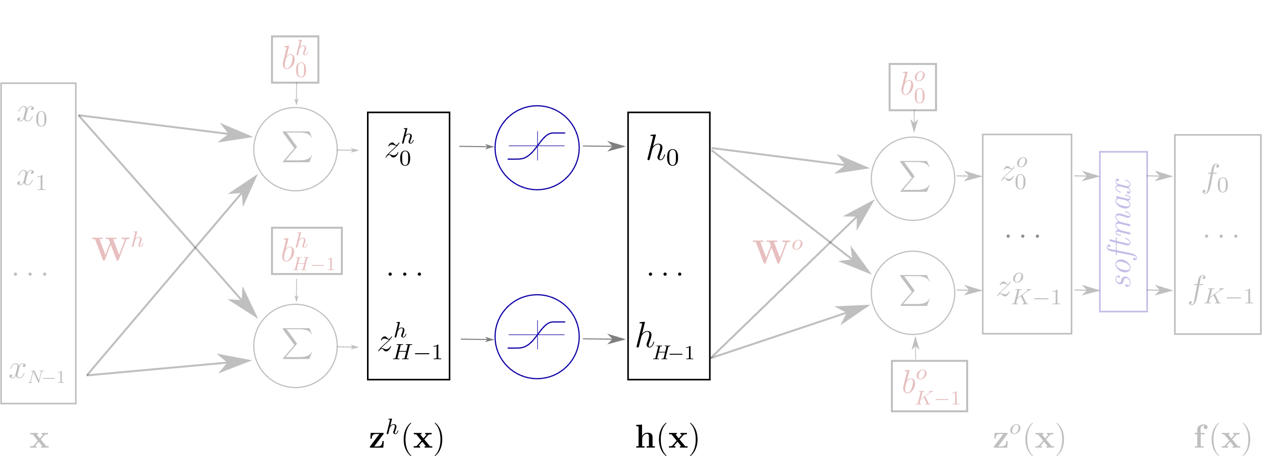
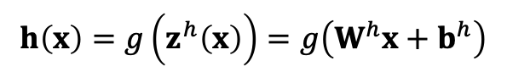
One Hidden Layer Network
$$z^{h}\left(x\right)=W^{h}x+b^{h}$$
$$h\left(x\right)=g\left(z^{h}\left(x\right)\right)=g\left(W^{h}x+b^{h}\right)$$

Slide 28
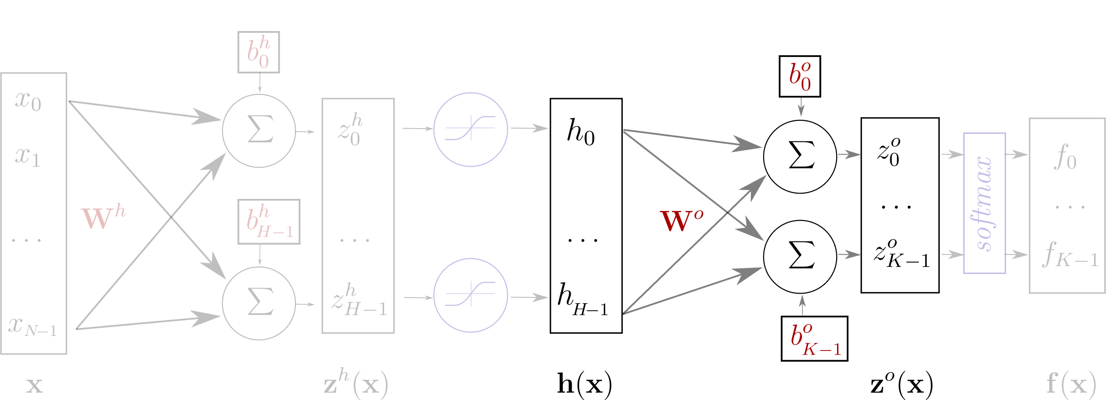
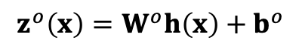
One Hidden Layer Network
$$z^{h}\left(x\right)=W^{h}x+b^{h}$$
$$h\left(x\right)=g\left(z^{h}\left(x\right)\right)=g\left(W^{h}x+b^{h}\right)$$
$$z^{o}\left(x\right)=W^{o}h\left(x\right)+b^{o}$$

Slide 29
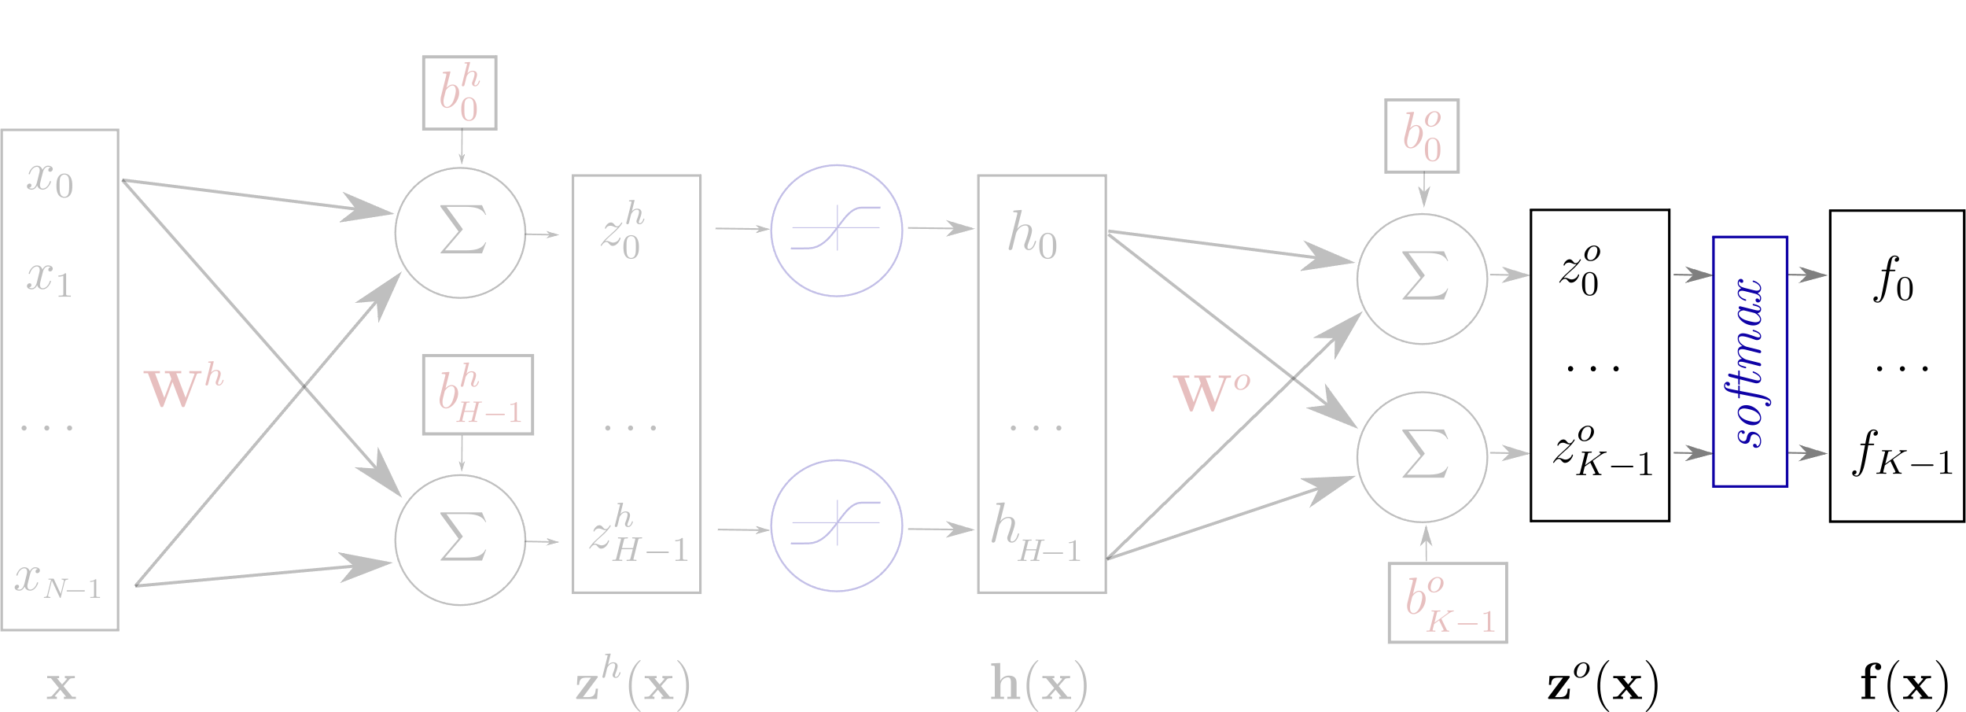
One Hidden Layer Network
$$z^{h}\left(x\right)=W^{h}x+b^{h}$$
$$h\left(x\right)=g\left(z^{h}\left(x\right)\right)=g\left(W^{h}x+b^{h}\right)$$
$$z^{o}\left(x\right)=W^{o}h\left(x\right)+b^{o}$$
$$f\left(x\right)=softmax\left(z^{o}\right)=softmax\left(W^{o}h\left(x\right)+b^{o}\right)$$

Slide 30
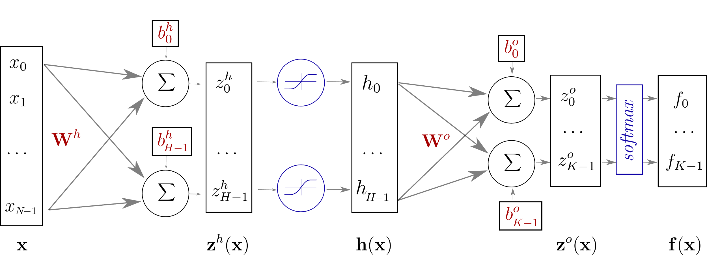
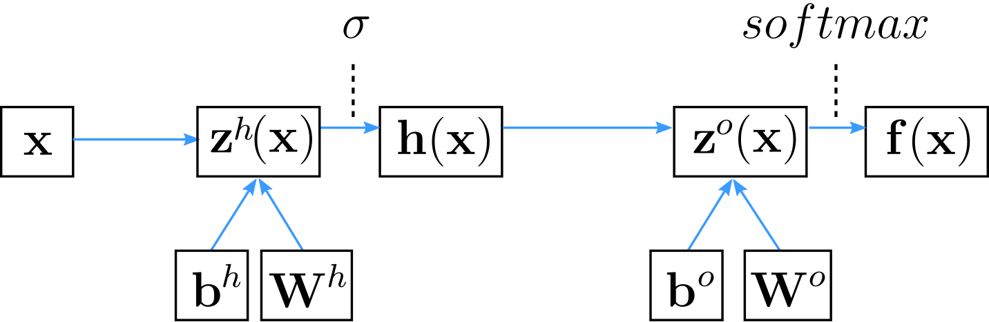
One Hidden Layer Network
Computational Graph

Slide 31
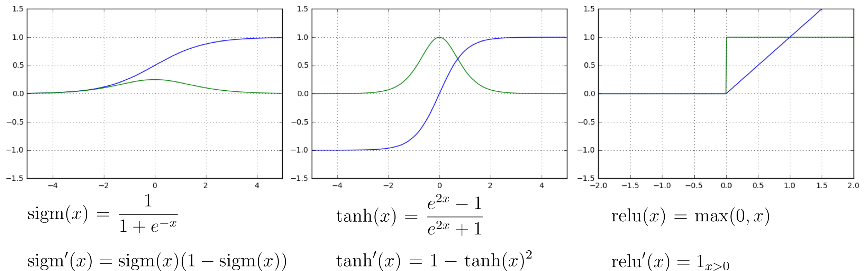
Element-wise activation functions
blue: activation function
green: derivative

Slide 32
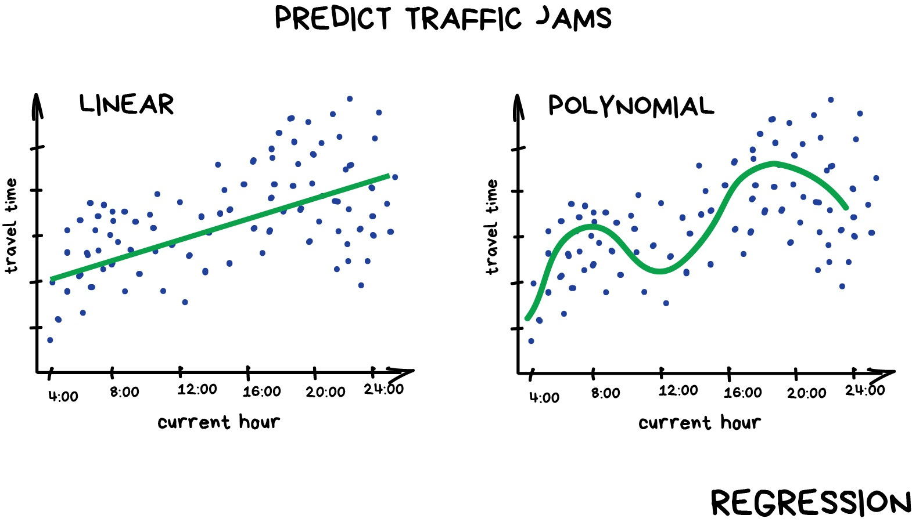
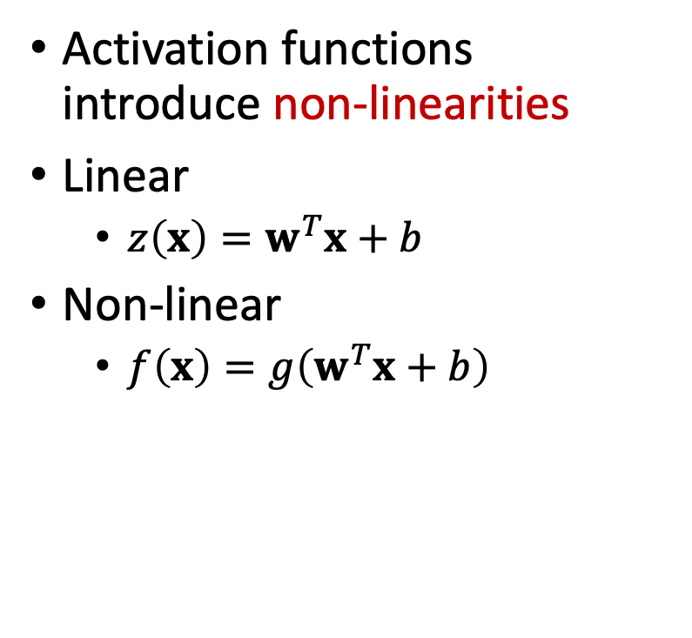
Activation Functions
Activation functions introduce non-linearities
Linear
$z\left(x\right)=w^{T}x+b$
Non-linear
$f\left(x\right)=g\left(w^{T}x+b\right)$
What if polynomial regression still could not find a good fit?

Slide 33
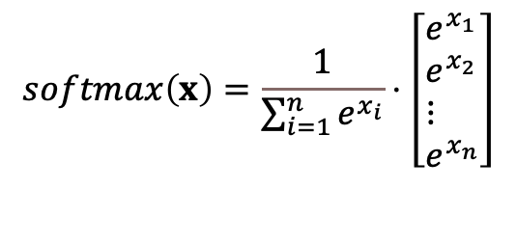
Softmax function
“Any time we wish to represent a probability distribution over a discrete variable with n possible values, we may use the softmax function. This can be seen as a generalization of the sigmoid function which was used to represent a probability distribution over a binary variable.” Deep Learning
$$softmax\left(x\right)=\frac{1}{\sum_{i=1}^{n}{e^{x_{i}}}}⋅\left[\begin{aligned}&e^{x_{1}} \\ &e^{x_{2}} \\ &⋮ \\ &e^{x_{n}}\end{aligned}\right]$$

Slide 34
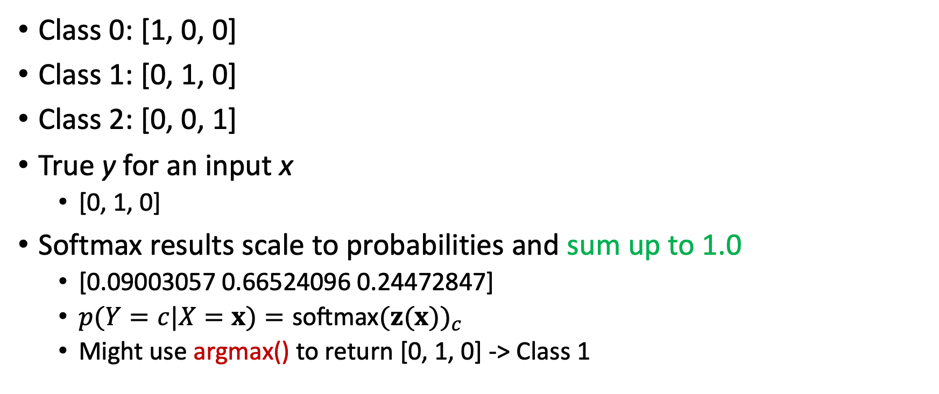

Softmax Example
Class 0: [1, 0, 0]
Class 1: [0, 1, 0]
Class 2: [0, 0, 1]
True y for an input x
[0, 1, 0]
Softmax results scale to probabilities and sum up to 1.0
[0.09003057 0.66524096 0.24472847]
$p(Y=c|X=x)=\text{softmax}(z(x))_{c}$
Might use argmax() to return [0, 1, 0] -> Class 1
$$softmax\left(x\right)=\frac{1}{\sum_{i=1}^{n}{e^{x_{i}}}}⋅\left[\begin{aligned}&e^{x_{1}} \\ &e^{x_{2}} \\ &⋮ \\ &e^{x_{n}}\end{aligned}\right]$$
https://machinelearningmastery.com/softmax-activation-function-with-python/#:~:text=The%20softmax%20function%20is%20used%20as%20the%20activation%20function%20in,more%20than%20two%20class%20labels.

Slide 35
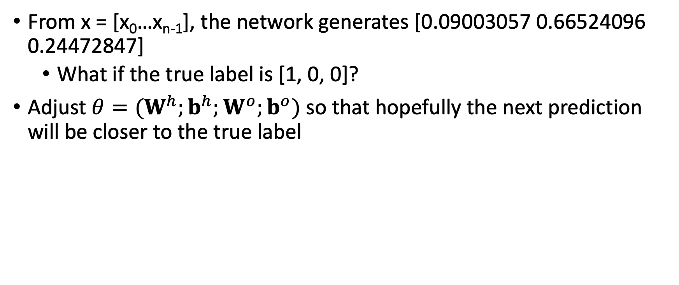
Training the network
From x = [x₀…x_{n-1}], the network generates [0.09003057 0.66524096 0.24472847]
What if the true label is [1, 0, 0]?
Adjust $θ=(W^{h};b^{h};W^{o};b^{o})$ so that hopefully the next prediction will be closer to the true label

Slide 36
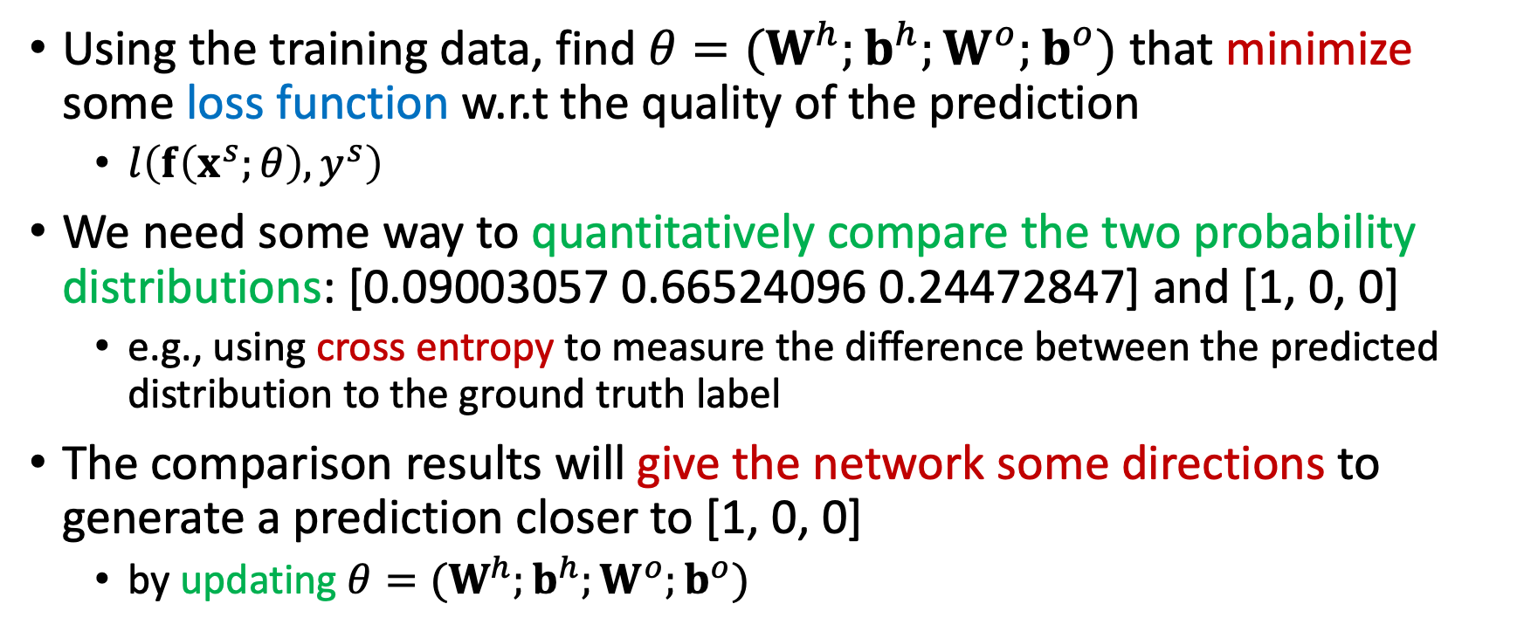
Training the network
Using the training data, find $θ=(W^{h};b^{h};W^{o};b^{o})$ that minimize some loss function w.r.t the quality of the prediction
$l\left(f\left(x^{s};θ\right),y^{s}\right)$
We need some way to quantitatively compare the two probability distributions: [0.09003057 0.66524096 0.24472847] and [1, 0, 0]
e.g., using cross entropy to measure the difference between the predicted distribution to the ground truth label
The comparison results will give the network some directions to generate a prediction closer to [1, 0, 0]
by updating $θ=(W^{h};b^{h};W^{o};b^{o})$
Notes:
This probability distribution has no information as the outcome is certain. We know the class. Therefore the entropy for this variable is zero. This means that the cross entropy of two distributions (real and predicted) that have the same probability distribution for a class label, will also always be 0.0.

Slide 37
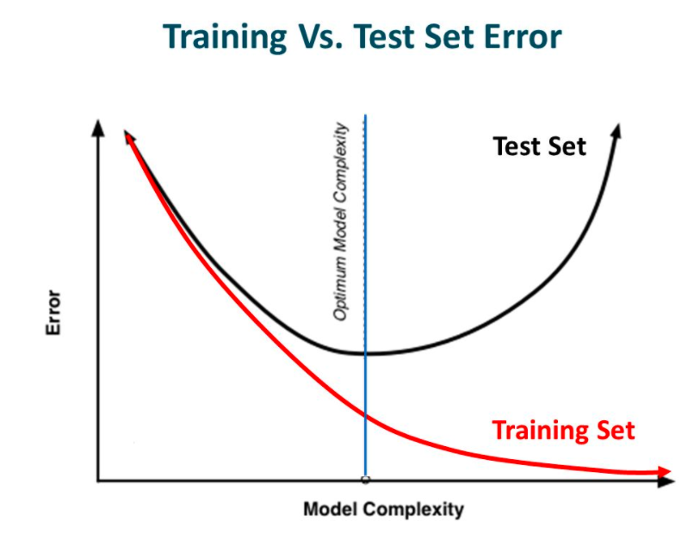
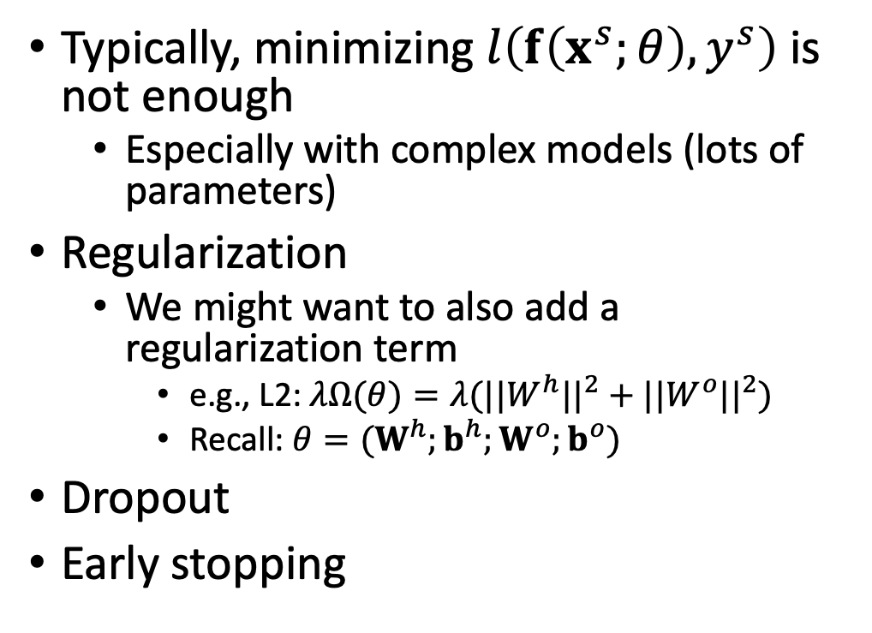
Avoid Overfitting
Typically, minimizing $l\left(f\left(x^{s};θ\right),y^{s}\right)$ is not enough
Especially with complex models (lots of parameters)
Regularization
We might want to also add a regularization term
e.g., L2: $λΩ(θ)=λ(||W^{h}||^{2}+||W^{o}||^{2})$
Recall: $θ=(W^{h};b^{h};W^{o};b^{o})$
Dropout
Early stopping
https://www.analyticsvidhya.com/blog/2018/04/fundamentals-deep-learning-regularization-techniques/
Notes:
L1 regularization penalizes the sum of absolute values of the weights, whereas L2 regularization penalizes the sum of squares of the weights.
The L1 regularization solution is sparse. The L2 regularization solution is non-sparse.
L2 regularization doesn’t perform feature selection, since weights are only reduced to values near 0 instead of 0. L1 regularization has built-in feature selection.
L1 regularization is robust to outliers, L2 regularization is not.

Slide 38
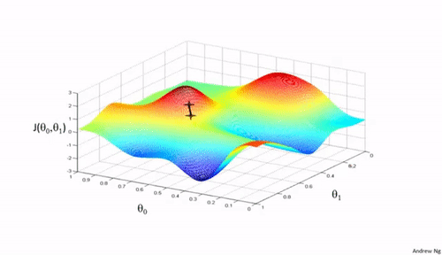
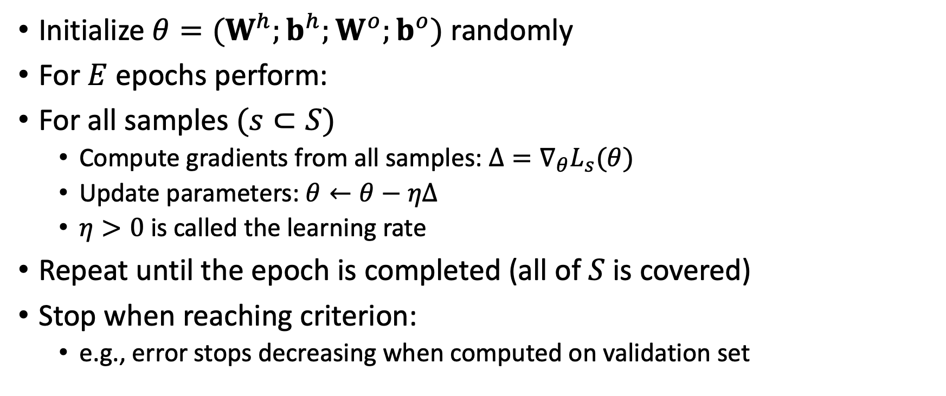
Gradient Descent
Initialize $θ=(W^{h};b^{h};W^{o};b^{o})$ randomly
For $E$ epochs perform:
For all samples$(s⊂S)$
Compute gradients from all samples: $Δ=∇_{θ}L_{s}(θ)$
Update parameters: $θ←θ−ηΔ$
$η>0$ is called the learning rate
Repeat until the epoch is completed (all of $S$ is covered)
Stop when reaching criterion:
e.g., error stops decreasing when computed on validation set

Slide 39
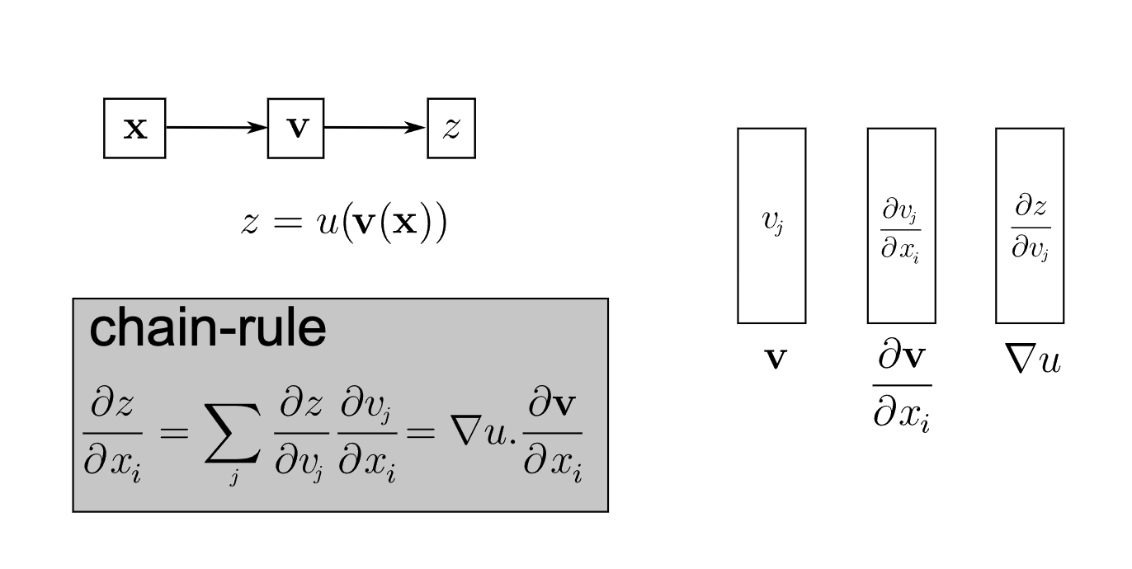
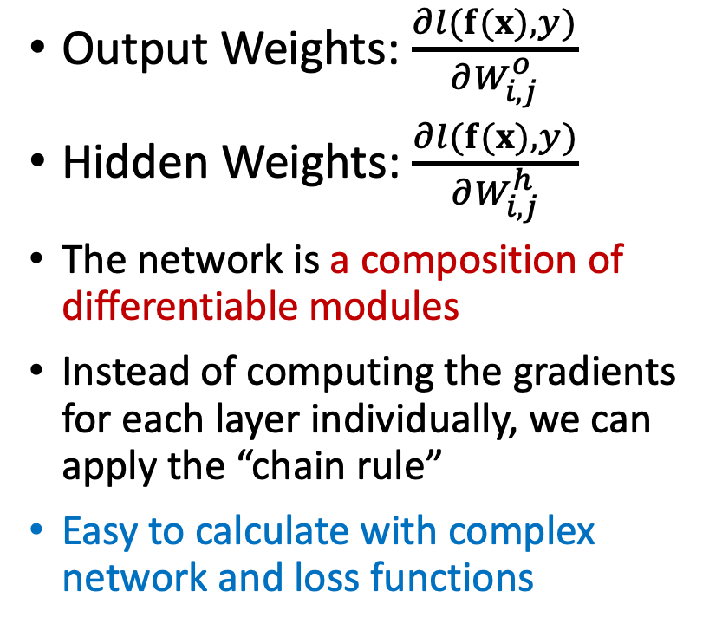
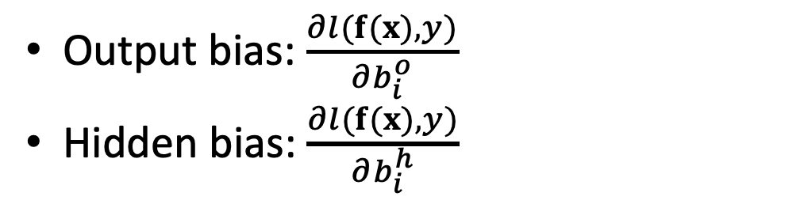
Computing Gradients
Output Weights: $\frac{∂l(f(x),y)}{∂W_{i,j}^{o}}$
Hidden Weights: $\frac{∂l(f(x),y)}{∂W_{i,j}^{h}}$
The network is a composition of differentiable modules
Instead of computing the gradients for each layer individually, we can apply the “chain rule”
Easy to calculate with complex network and loss functions
Output bias: $\frac{∂l(f(x),y)}{∂b_{i}^{o}}$
Hidden bias: $\frac{∂l(f(x),y)}{∂b_{i}^{h}}$

Slide 40
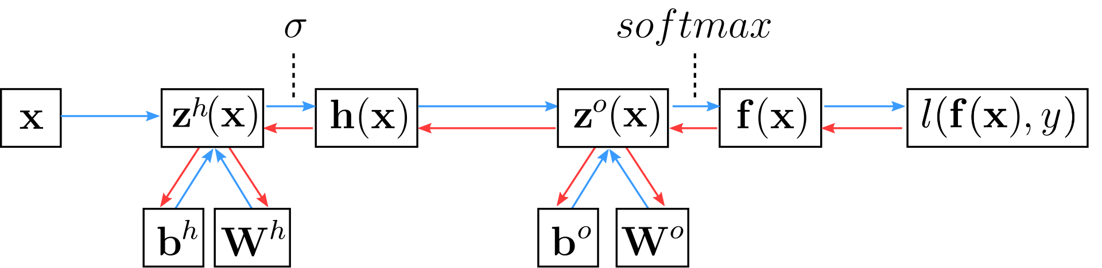
Backpropagation
https://towardsdatascience.com/understanding-backpropagation-algorithm-7bb3aa2f95fd
https://machinelearningmastery.com/difference-between-backpropagation-and-stochastic-gradient-descent/

Slide 41

Stochastic Gradient Descent with Mini Batch
Initialize $θ=(W^{h};b^{h};W^{o};b^{o})$ randomly
For $E$ epochs perform:
Randomly select a small batch (mini-batch) of samples$(B⊂S)$
Compute gradients: $Δ=∇_{θ}L_{B}(θ)$
Update parameters: $θ←θ−ηΔ$
$η>0$ is called the learning rate
Repeat until the epoch is completed (all of $S$ is covered)
Stop when reaching criterion:
e.g., error stops decreasing when computed on validation set
Watch me: https://www.youtube.com/watch?v=vMh0zPT0tLI

Slide 42

Initialization and Learning
Normalize your input
Initialize weights with random numbers (bias to 0)
Adjust SGD learning rate
Momentum
Accumulate gradients across successive updates
Other optimizers
Credits: Alec Radford

Slide 43
Many Types of Neural Network Architectures
Graph Neural Networks
Convolutional Neural Networks
Recurrent Neural Networks
Transformer
We can also mix them!

Slide 44



Graph Neural Networks
https://giters.com/liyaguang/DCRNN
http://snap.stanford.edu/decagon/
Notes:
2/23

Slide 45

Convolutional Neural Networks
https://towardsdatascience.com/a-comprehensive-guide-to-convolutional-neural-networks-the-eli5-way-3bd2b1164a53

Slide 46

Recurrent Neural Networks
https://towardsdatascience.com/language-translation-with-rnns-d84d43b40571

Slide 47

Transformer
https://towardsdatascience.com/bert-explained-state-of-the-art-language-model-for-nlp-f8b21a9b6270

Slide 48
Neural Networks & DL Summary
DL is very versatile and can capture non-linear relationships
DL can take advantage of large amounts of training data
Design a DL network include the decisions of network architectures, loss functions, and regularizer
Training a DL network concerns initialization (including data normalization), learning rate, learning algorithms, and batch sizes (SGD)
Many open-source tools, books, and tutorials are available online

Slide 49
Convolutional Neural Networks
A short introduction

Slide 50

Image as Functions
https://ai.stanford.edu/~syyeung/cvweb/tutorial1.html

Slide 51

Image as Functions
https://ai.stanford.edu/~syyeung/cvweb/tutorial1.html

Slide 52
Image Classification with Dense Layers
How many parameters do we need?
Two hidden layers
Fully connected
Assuming a 28 x 28 image, 3 channels (RGB), 2 layers, 1,000 neuron each
28 x 28 x 3 x 1000 + 1000 x 1000 + 2 x 1000 = 3.3M!
https://vas3k.com/blog/machine_learning/

Slide 53
Image Classification with Dense Layers
Spatial structure is not used
Spatial relations between pixel values
The input image is “flattened”
From 2D pixels to 1D inputs
https://vas3k.com/blog/machine_learning/

Slide 54


Image Filters, Convolution, Kernel
https://ai.stanford.edu/~syyeung/cvweb/tutorial1.html

Slide 55

Image Filters, Convolution, Kernel
https://ai.stanford.edu/~syyeung/cvweb/tutorial1.html

Slide 56
Image Filters, Convolution, Kernel
Apply a convolution kernel on the image to generate another image
The output image can have a different size from the input image, depending on the kernel sizes/types, stride sizes, and padding methods
Each cell in the output image summarizes a 3 x 3 area in the original image
The same summarization operation for every cell, e.g., use the average intensity
16 x 12
5 x 4
https://github.com/vdumoulin/conv_arithmetic

Slide 57

Strides
Strides: increment step size for the convolution operator
Reduces the size of the output map
A stride of 2:

Slide 58

Padding
Padding: artificially fill borders of image
Useful to keep spatial dimension constant across filters
Useful with strides and large receptive fields
Usually: fill with 0s

Slide 59


Padding

Slide 60

Sizes and Dimensions
Assuming square input, dimension i x i
Padding size = p
Stride size = 1
Kernel size = k
Output dimension = o x o
$$o = \left(i – k\right)+ 2× p + 1$$
Read https://arxiv.org/abs/1603.07285

Slide 61


Sizes and Dimensions
$$o = \left(i – k\right) + 2 × p + 1$$
https://arxiv.org/abs/1603.07285

Slide 62

Sizes and Dimensions
$$o = \left(i – k\right) + 2 × p + 1$$
https://arxiv.org/abs/1603.07285

Slide 63


Sizes and Dimensions
$$o = \left(i – k\right)+ 2×p + 1;k=2 ×p+1$$
https://arxiv.org/abs/1603.07285

Slide 64


Sizes and Dimensions
$$o = \left(i – k\right)+ 2×p + 1;p=k−1$$
https://arxiv.org/abs/1603.07285

Slide 65



Convolution in Neural Networks
$x$ is a $3×3$ chunk (dark area) of the image (blue array)
Kernel is the subscripts in the dark area
A neuron is parameterized with the kernel
$3×3$ weight matrix $w$
Image: im, dimensions 5x5
Kernel: k, dimensions 3x3
$$\left(k⋆im\right)(x, y)=\sum_{n=0}^{2}{\sum_{m=0}^{2}{k(n,m).im(x+n −1, y+m −1)}}$$
https://arxiv.org/abs/1603.07285

Slide 66



Convolution in Neural Networks
$x$ is a $3×3$ chunk (dark area) of the image (blue array)
Kernel is the subscripts in the dark area
A neuron is parameterized with the kernel
$3×3$ weight matrix $w$
The activation obtained by sliding the kernel window to compute: $z(x)=relu(w^{T}x+b)$
Image: im, dimensions 5x5
Kernel: k, dimensions 3x3
$$w^{T}x$$
$$\left(k⋆im\right)(x, y)=\sum_{n=0}^{2}{\sum_{m=0}^{2}{k(n,m).im(x+n −1, y+m −1)}}$$
https://arxiv.org/abs/1603.07285

Slide 67
Motivations
Kernel dimensions + 1
Local connectivity
A neuron depends only on a few local input neurons
Translation invariance
Comparison to Fully connected
Parameter sharing, reduce overfitting
Make use of spatial structure: strong prior for vision!
…
Convolutional layer
#current layer neurons x #previous layer neurons + #current layer neurons
1D Convolution View: How many parameters do we need?
?
…
Fully connected (dense layer)

Slide 68



Multiple Channels
Colored image = tensor of shape (height, width, channels)
Convolutions are usually computed for each channel separately and summed:
$$\left(k⋆im^{color}\right)=\sum_{c=0}^{2}{k^{c}⋆im^{c}}$$

Slide 69

Multiple Convolutions
Multiple kernel sizes aka receptive fields (usually 1, 3, 5, 7, 11)

Slide 70

Multiple Convolutions
Multiple kernel sizes aka receptive fields (usually 1, 3, 5, 7, 11)

Slide 71

Multiple Convolutions
Multiple kernel sizes aka receptive fields (usually 1, 3, 5, 7, 11)

Slide 72


Multiple Convolutions
Multiple kernel sizes aka receptive fields (usually 1, 3, 5, 7, 11)

Slide 73


Pooling
Spatial dimension reduction
Local invariance
No parameters: max or average of 2x2 units
http://cs231n.github.io/convolutional-networks

Slide 74
Put it all together
Input
Conv blocks
Convolution + activation (relu)
Convolution + activation (relu)
...
Maxpooling 2x2
Output
Fully connected layers
Softmax

Slide 75


AlexNet
First conv layer: kernel 11x11x3x96 stride 4
Kernel shape: (11,11,3,96)
Output shape: (55,55,96)
Number of parameters: 34,944
Equivalent MLP parameters: 43.7 x 1e9
Simplified version of Krizhevsky, Alex, Sutskever, and Hinton. "Imagenet classification with deep convolutional neural networks." NIPS 2012

Slide 76

Hierarchical Representation

Slide 77
AlexNet
One of the first deep convolutional networks to achieve considerable accuracy on the 2012 ImageNet LSVRC-2012 challenge
84.7% vs 73.8% (second best)
Data augmentation and dropout layers to reduce overfitting
Use ReLu to avoid the vanishing gradient problem

Slide 78
Vanishing gradient problem
Recall that the optimization process is based on backpropagation of gradient computed with the loss function
When the gradients are already small, the chain rule makes the gradients of the earlier layers even smaller (e.g., decreases exponentially the number of layers)
Earlier layers are difficult to train – weights do not change due to the small gradients
Why Relu can help?
blue: activation function
green: derivative
Notes:
Stopped her

Slide 79

Let’s go deeper: VGG-16
More layers than AlexNet
138m vs 62m parameters
Effectively use fixed size, small kernels to replace larger, variable size kernels
Building blocks:
Conv, Conv, Max Pooling or
Conv, Conv, Conv, Max Pooling
138 million parameters
Simonyan, Karen, and Zisserman. "Very deep convolutional networks for large-scale image recognition." (2014)
Notes:
https://towardsdatascience.com/the-w3h-of-alexnet-vggnet-resnet-and-inception-7baaaecccc96

Slide 80


Let’s go wider: GoogleNet Inception
Capture global (semantic) information with larger kernel
Capture local (spatial) information with smaller kernel
Use multiple variable size kernels in the same layer
Fewer layers, easier to train
Still capture both global and local information

Slide 81

1D convolution in GoogleNet
Reduce the number of channels
Summed
Selectively squeeze information from multiple channels in the previous layer to 1 channel
Like dimension reductions
Allow efficient use of multiple kernels
https://andre-ye.medium.com/the-clever-trick-behind-googles-inception-the-1-1-convolution-58815b20113

Slide 82


Can we go deeper again? ResNet
More layers, deeper models
34, 50, 101, 152 layers
Skipped connections pass information across layers
Mitigate (but not solve) the vanishing gradient problem
He, Kaiming, et al. "Deep residual learning for image recognition." CVPR. 2016.

Slide 83

Residual Connections
Also called the skipped or skip connections
Used in many different types of neural networks to facilitate training (e.g., mitigate the vanish gradient problem)
https://towardsdatascience.com/what-is-residual-connection-efb07cab0d55

Slide 84


Residual Connections
As ensembles of shallow neural networks
Empirically, residual connections often help generate better models and results, e.g., see DenseNet
https://towardsdatascience.com/what-is-residual-connection-efb07cab0d55

Slide 85

from Kaiming He slides "Deep residual learning for image recognition." ICML. 2016.

Slide 86

AlexNet, VGG, Inception, ResNet
FLOP = floating point operations (required for a forward pass)
e.g., training AlexNet would take similar time as training Inception
https://towardsdatascience.com/the-w3h-of-alexnet-vggnet-resnet-and-inception-7baaaecccc96

Slide 87

State of the Art
Meta Pseudo Labels, Hieu Pham et al. (Jan 2021)

Slide 88

State of the Art
https://paperswithcode.com/sota/image-classification-on-imagenet

Slide 89

Pre-trained Models
Training a model on ImageNet (14m+ annotated images) from scratch takes days or weeks.
Many models trained on ImageNet and their weights are publicly available

Slide 90
ImageNet & Pre-trained Models
Many models trained on ImageNet and their weights are publicly available
Transfer learning
Use pre-trained weights, remove last layers to compute representations of images
Train a classification model from these features on a new classification task
The network is used as a generic feature extractor
Better than handcrafted feature extraction on natural images

Slide 91
Fine-tuning Pre-trained Models
Fine-tuning
Retraining the (some) parameters of the network (given enough data)
Truncate the last layer(s) of the pre-trained network
Freeze the remaining layers weights
Add a (linear) classifier on top and train it for a few epochs
Then fine-tune the whole network or the few deepest layers
Use a smaller learning rate when fine tuning

Slide 92

PyTorch Tutorial
Finetuning the convnet: initialize the network with a pretrained network. Rest of the training looks as usual.
ConvNet as fixed feature extractor: freeze the weights for all of the network except that of the final fully connected layer. This last fully connected layer is replaced with a new one with random weights and only this layer is trained.
…
https://pytorch.org/tutorials/beginner/transfer_learning_tutorial.html
https://towardsdatascience.com/review-resnet-winner-of-ilsvrc-2015-image-classification-localization-detection-e39402bfa5d8

Slide 93

Fine-tuning Example
Semantic segmentation results (overlaying with the test map) using pre-trained PSPNet with large size training data and trained from the shallow (top left), middle (top right), and deep layers (bottom left) (FP in red and TP in blue)
Notes:
stop

Slide 94
Bias and Ethical Concerns
Neural networks are great approximators
You get what you trained with
Training data can have bias
Model can have bias
Applications can discriminate against certain populations
“In July 2020, the National Institute of Standards and Technology (NIST) conducted independent assessments to confirm these results. It reported that facial recognition technologies for 189 algorithms showed racial bias toward women of color. NIST also concluded that even the best facial recognition algorithms studied couldn’t correctly identify a mask-wearing person nearly 50% of the time.”
https://learn.g2.com/ethics-of-facial-recognition

Slide 95
CNN Summary
A powerful neural network architecture for many tasks, especially computer vision
Reduce the number of parameters (parameter sharing)
Capture spatial interactions in a neighborhood (i.e., the kernel size)
Capture consistent spatial interactions across the input space (e.g., the input image) – could be a limitation
Many types of CNN architectures and pretrained models are available
Models can have bias and ethical concerns should be addressed

Slide 96
Acknowledgements
Deep learning slides adapted from https://m2dsupsdlclass.github.io/lectures-labs/ by Olivier Grisel and Charles Ollion (CC-By 4.0 license)
Gil, Yolanda (Ed.) Introduction to Computational Thinking and Data Science. Available from http://www.datascience4all.org

Slide 97

These materials are released under a CC-BY License
https://creativecommons.org/licenses/by/2.0/
You are free to:
Share — copy and redistribute the material in any medium or format
Adapt — remix, transform, and build upon the material
for any purpose, even commercially.
The licensor cannot revoke these freedoms as long as you follow the license terms.
Under the following terms:
Attribution — You must give appropriate credit, provide a link to the license,
and indicate if changes were made. You may do so in any reasonable manner,
but not in any way that suggests the licensor endorses you or your use.
Artwork taken from other sources is acknowledged where it appears.
Artwork that is not acknowledged is by the author.
Please credit as: Chiang, Yao-Yi Introduction to Spatial Artificial Intelligence. Available from https://yaoyichi.github.io/spatial-ai.html
If you use an individual slide, please place the following at the bottom: “Credit: https://yaoyichi.github.io/spatial-ai.html
We welcome your feedback and contributions.
Credit: http://www.datascience4all.org/

